Slide 1

Taxi Trajectory Analysis
Prateek Agrawal, Paul Cherian, Dong Hyuk Kim, Danny Lee

Slide 2
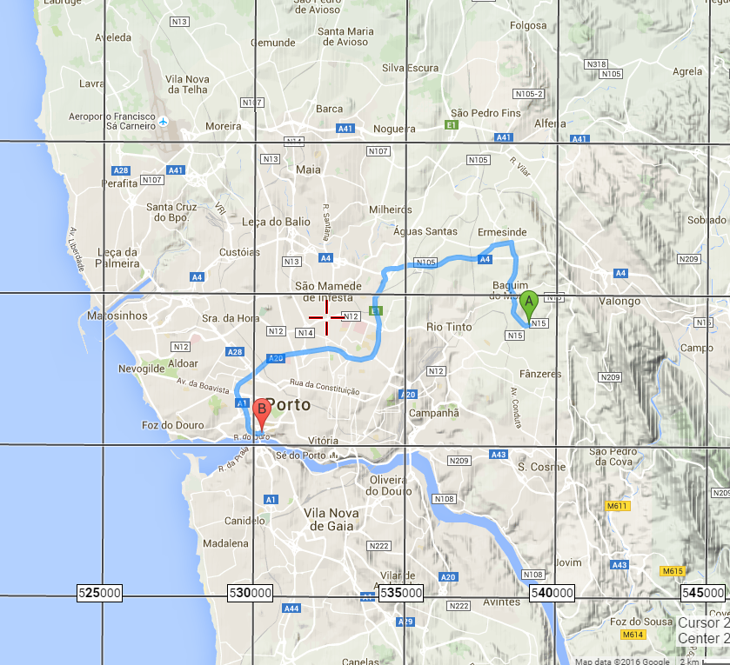
Introduction
Electronic dispatch systems (one-to-one) have replaced VHR-radio sytem (one-to-many).
Taxis do not enter their drop-off location
Predicting the drop-off location of taxis in service using their spatial trajectories

Slide 3
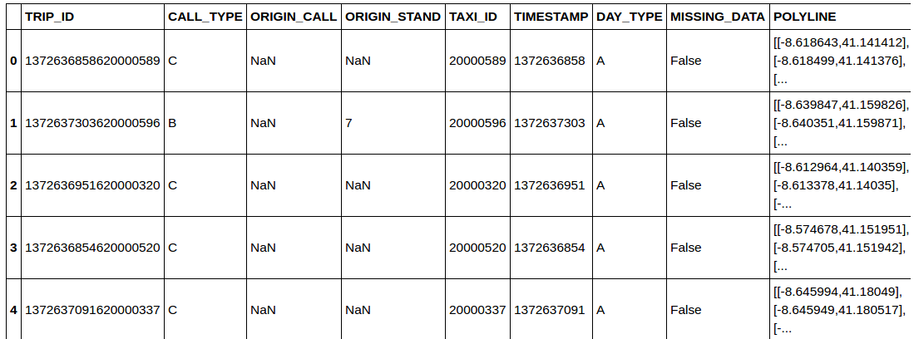
Data Description
A year’s worth of 1.7 million observations of taxi trips (7/1/2014~6/30/2015) of 442 taxis operating in Porto, Portugal.

Slide 4
TRIP_ID is the unique ID for all trips
TAXI_ID is the unique taxi numbers
TIMESTAMP is the date and time of the trip
POLYLINE includes GPS coordinates of the taxi trip that are taken in 15 second intervals

Slide 5
Data Pre-Processing
Divided the area of the city of Porto, Portugal into a grid in latitutude and longitudes to bin different locations (grid resolution: 500m).
Converted all latitude and longitude from degree to meter to plot them in 2D space.
Timestamp is converted to date time format from posix format.
Last grid as end destination grid.
1st Label as starting grid

Slide 6
Methods Used
KNN clustering
Neural Networks

Slide 7
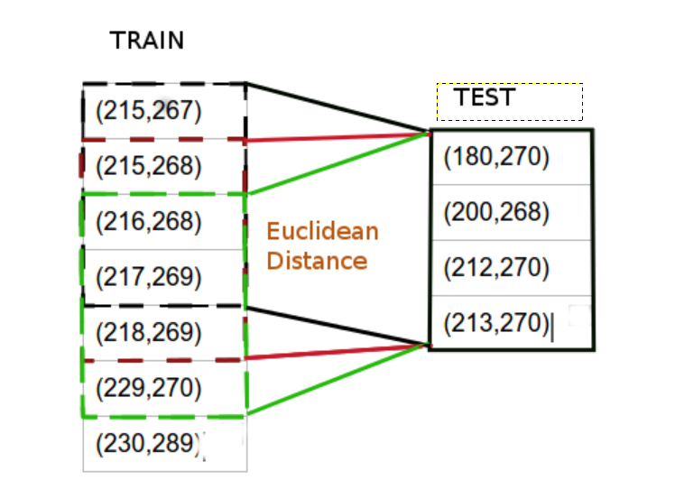
K-NEAREST NEIGHBOURS
Find K nearest trips that have similar trajectories.
Use N latest coordinates from test set.
Create a sliding window to calculate similarity across train coordinates
Sum of euclidean distance as similarity metric

Slide 8
Multiprocessing
Training data huge: 1.7 million records
Use multiprocessing package in python to distribute the workload
Creates seperate processes for calculating similarity with each training data point.
Used vectorized operations

Slide 9
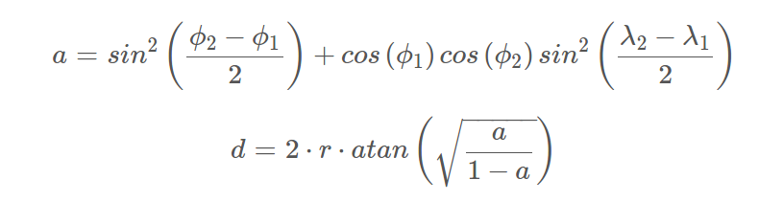
Parameter Tuning
Did 5 fold cross validation on subset of training data to tune parameters
The evaluation metric is Mean Haversine Distance
Parameter Set (K,N) | Mean Harvensine Distance
(3,5) | 2.621
(5,5) | 2.582
(5,3) | 2.653
(5,7) | 2.581
(7,7) | 2.618

Slide 10
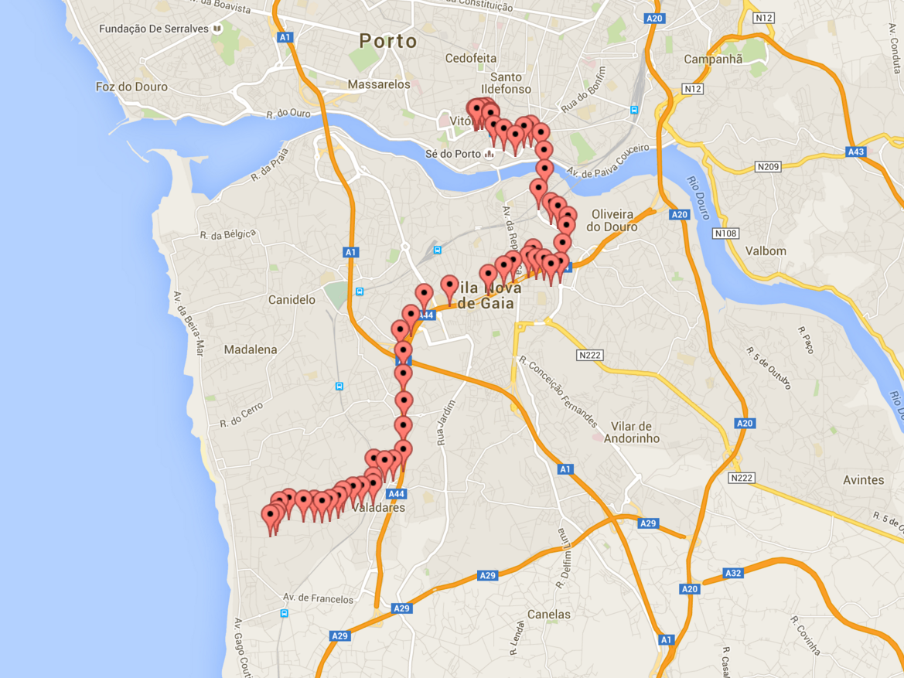
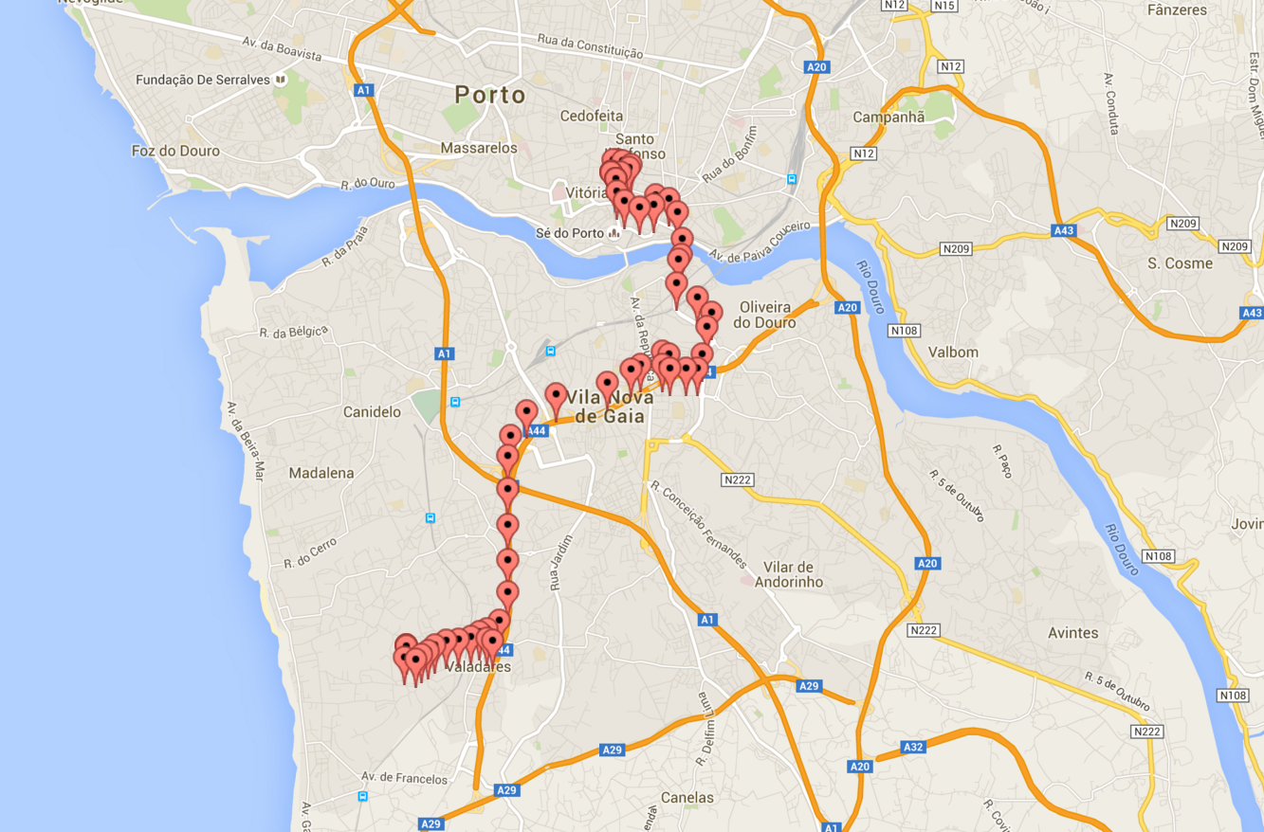
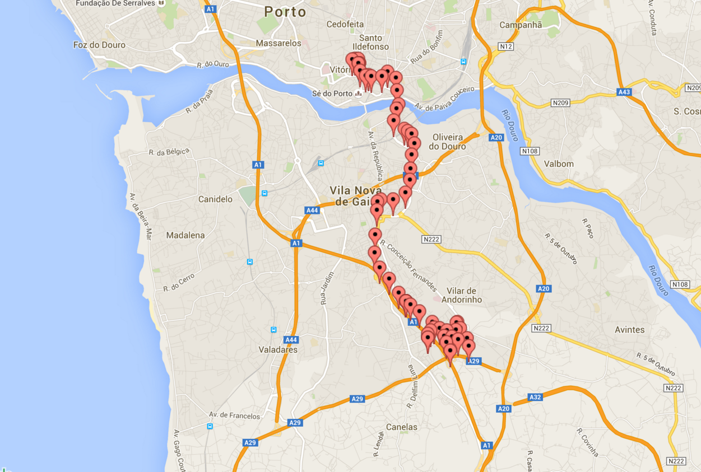
Results
TEST OBSERVATION
Neighbour 1 Neighbour 10

Slide 11

Artificial Neural Network (ANN)
Modeling functional relationships between covariates and response variable
Used the package neuralnet (R)
Trained a multi-layer perceptrons model to classify each trip on basis of destination grid
We used 3 nodes i
Used Backpropogation algorithm to reduce the errors
Supervised Learning Algorithm

Slide 12
Approach
Conversion of categorical variable into dummy variables.
Encoded labels with value between 0 and n-1
Normalization
Random split of data into a train and a test set

Slide 13
Graphical Representation of the Model
We trained the model based on label-
encoded Taxi-ID’s, Starting grid label
and CALL_TYPE.
The output of the analysis predicts
the label in which the trip ends
Performed cross-validation with the
test data, we got an RMSE of 0.092

Slide 14
Conclusions
Testing the Neural Network on kaggle test data, we got the mean harvensine distance of 2.591
The KNN algorithm gave a mean harvensine distance of 2.623
Would have put us in top 25%

Slide 15
Questions?

